Slide 1

PowerShell Making GUI Applications
November 2017

Slide 2
Form Designer
Expensive software is not required to create friendly GUI interfaces for your script code. Consider these three free options:
Admin Script Editor
Poshgui.com
PowerShell_ISE Forms Builder
Poshgui creates really clean code and will be the default standard used in this presentation.
ASE and PoshGUI work the same as Visual Studio might in form design mode.
Forms Builder is best for very simple forms
Low cost software ($40):
PowerShell Pro Tools for Visual Studio

Slide 3
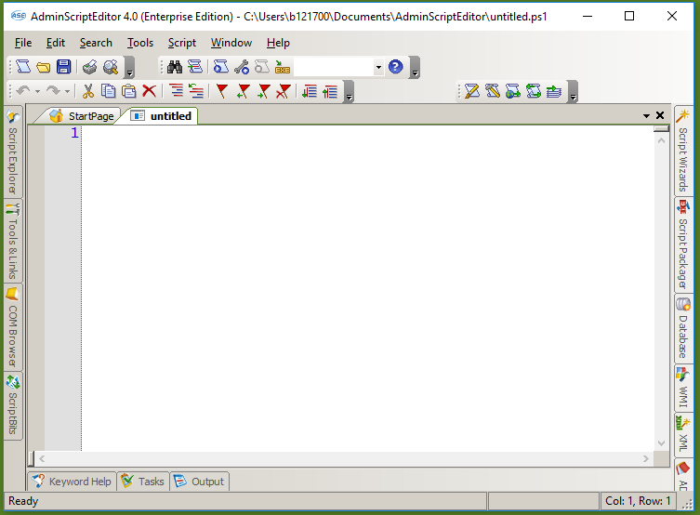
Admin Script Editor
Run Script
Launch Form Editor

Slide 4
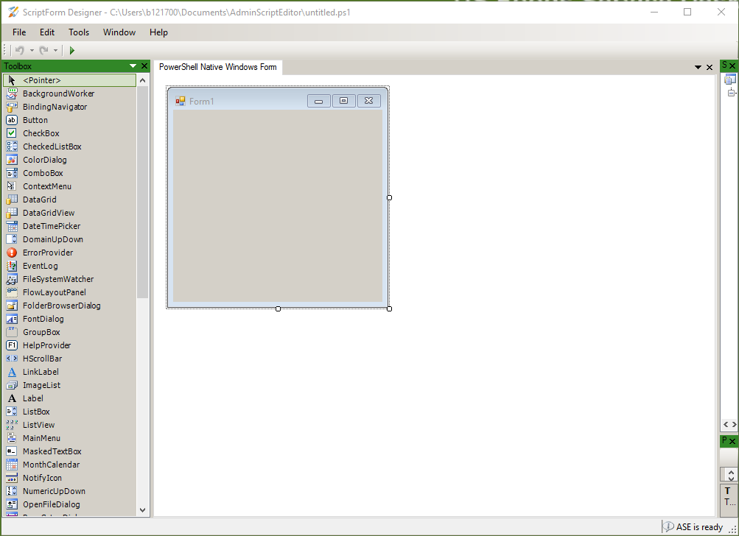
Admin Script Editor

Slide 5
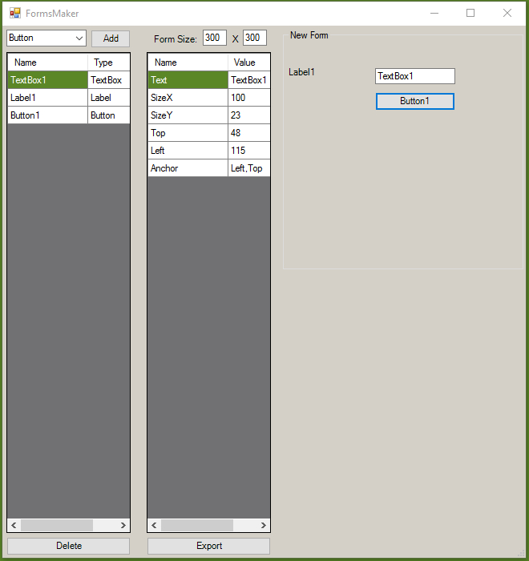
PowerShell_ISE Forms Builder

Slide 6
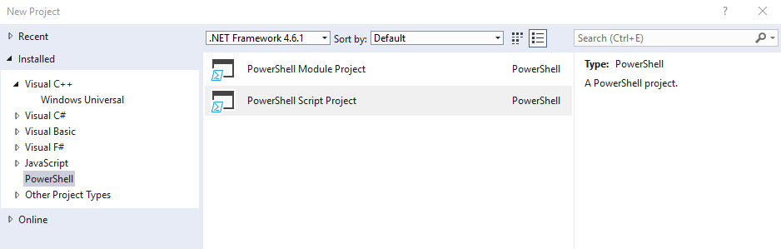
Visual Studio & PowerShell Pro Tools
Works with Visual Studio & Visual Studio Community Edition
Allows use of commonly known interface
Will combine script code and form code into a single file

Slide 7
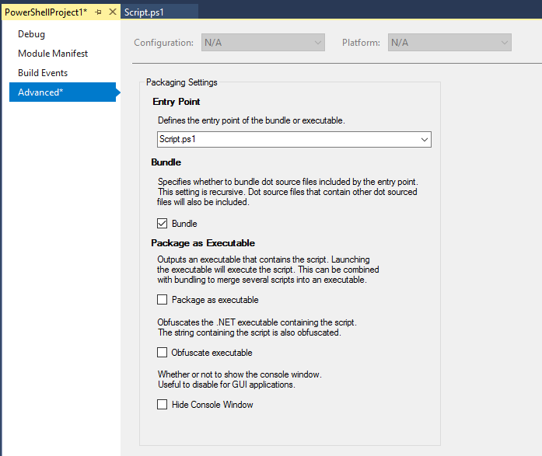
Visual Studio & PowerShell Pro Tools

Slide 8
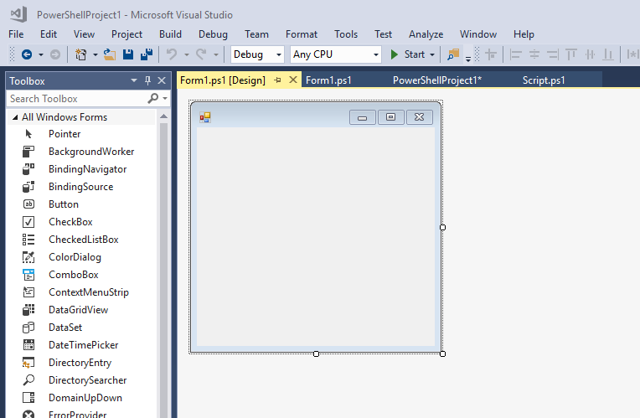
Visual Studio & PowerShell Pro Tools

Slide 9
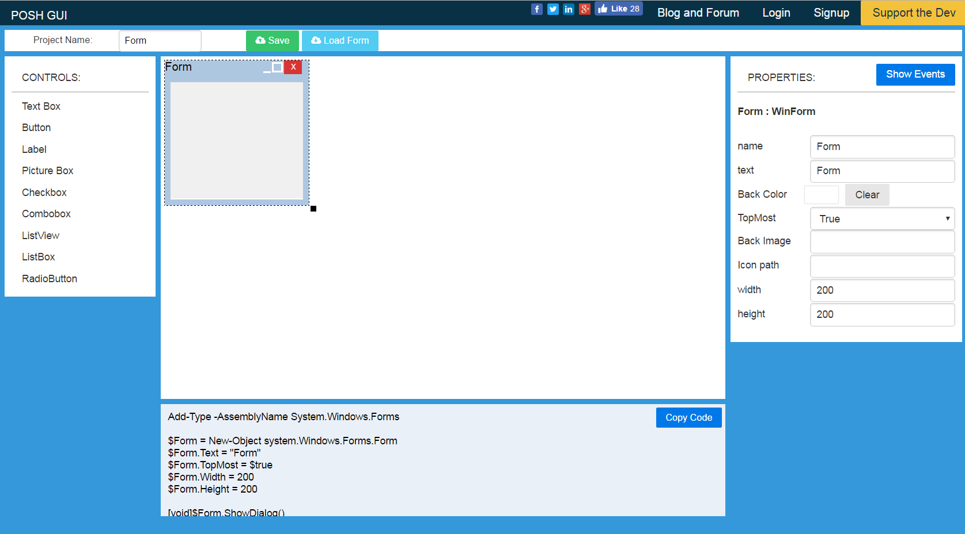
Basic GUI Design
Elements you can add to your form.
This is the name you use to reference your form in code.
This is what displays at the top of the form.
The actual PowerShell Code to make your form.

Slide 10
Agenda
We will begin our learning with the creation of a basic form.
Things we will consider and accomplish at the end of this module:
Create a form with labels, text boxes, buttons, checked list box and checkboxes
Add code to events
Allow user to browse to an OU
Dynamically populate a checked list box.
Query Active Directory
Create a new user
Delete a user

Slide 11
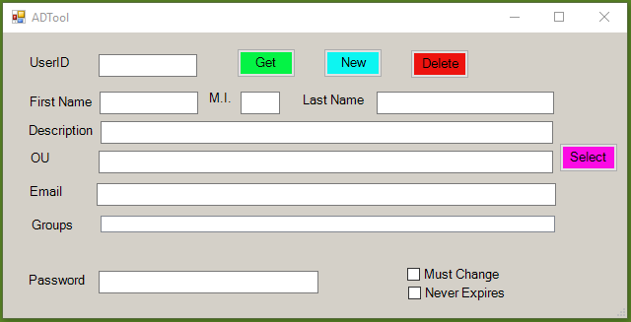
Simple AD Tool
Navigate to PoshGUI.com.
Create the following form. For the Groups box, use a ListBox.

Slide 12
Simple AD Tool
Use the Copy Code Button to copy to your clipboard.
Paste the code into PowerShell_ISE

Slide 13
Simple AD Tool – Basic Form
Add-Type -AssemblyName System.Windows.Forms
$ADTool = New-Object system.Windows.Forms.Form
$ADTool.Text = "ADTool"
$ADTool.TopMost = $true
$ADTool.Width = 649
$ADTool.Height = 329
$lblUSerID = New-Object system.windows.Forms.Label
$lblUSerID.Text = "UserID"
$lblUSerID.AutoSize = $true
$lblUSerID.Width = 25
$lblUSerID.Height = 10
$lblUSerID.location = new-object system.drawing.point(25,22)
$lblUSerID.Font = "Microsoft Sans Serif,10"
$ADTool.controls.Add($lblUSerID)
Etc..

Slide 14
Simple AD Tool – Select Button
Look for the Select Button Click event $btnSelect = New-Object system.windows.Forms.Button
$btnSelect.BackColor = "#fb0be4"
$btnSelect.Text = "Select"
$btnSelect.Width = 60
$btnSelect.Height = 30
$btnSelect.Add_Click({
#add here code triggered by the event
})
Paste the OU Selection code under the comment

Slide 15
Simple AD Tool – Groups List Box
Look for the Groups List Box Code
$lbGroups = New-Object system.windows.Forms.ListBox
$lbGroups.Width = 461
$lbGroups.Height = 22
$lbGroups.location = new-object system.drawing.point(99,186)
$ADTool.controls.Add($lbGroups)
Change the code from a ListBox to a CheckedListBox
#Changed from ListBox to CheckedListBox
$clbGroups = New-Object system.windows.Forms.CheckedListBox
$clbGroups.Width = 462
$clbGroups.Height = 44
$clbGroups.location = new-object system.drawing.point(99,186)
$ADTool.controls.Add($clbGroups)

Slide 16
Simple AD Tool – Get Button Click
Look for the Get Button Click Event code
$btnGet = New-Object system.windows.Forms.Button
$btnGet.BackColor = "#04f345"
$btnGet.Text = "Get"
$btnGet.ForeColor = "#080808"
$btnGet.Width = 60
$btnGet.Height = 30
$btnGet.Add_Click({
#add here code triggered by the event
})
Paste the Get code under the comment
#add here code triggered by the event
$UserID = $tbUserID.text
$User = Get-ADUser -Identity $UserID -Properties GivenName,initials,Surname,mail,Description,MemberOf,DistinguishedName | Select GivenName,initials,Surname,mail,Description,MemberOf,DistinguishedName
$FirstName = $User.GivenName
$MI = $User.initials
$LastName = $User.Surname

Slide 17
Simple AD Tool – New Button Click
Look for the New Button Click Event code
$btnNew = New-Object system.windows.Forms.Button
$btnNew.BackColor = "#0df5f1"
$btnNew.Text = "New"
$btnNew.Width = 60
$btnNew.Height = 30
$btnNew.Add_Click({
#add here code triggered by the event
})
$btnNew.location = new-object system.drawing.point(325,16)
$btnNew.Font = "Microsoft Sans Serif,10"
$ADTool.controls.Add($btnNew)
Paste the NewUser code under the comment

Slide 18
Simple AD Tool – Delete Button Click
Look for the New Button Click Event code
$btnDelete = New-Object system.windows.Forms.Button
$btnDelete.BackColor = "#ed130f"
$btnDelete.Text = "Delete"
$btnDelete.Width = 60
$btnDelete.Height = 30
$btnDelete.Add_Click({
#add here code triggered by the event
})
Paste the Delete code under the comment
$UserID = $tbUserID.Text
Remove-ADUser -Identity $UserID

